Slide 1
Nibs v2
(now with External Objects)
Dan Mehlman
dmehlman@heroku.com

Slide 2
This is the advanced course
We’re assuming you already have the appropriate Heroku and Salesforce accounts
If not, please sign up for them now:
Heroku Account
Salesforce Developer Account

Slide 3
Initial Setup
Install the unmanaged package in your Salesforce Org (available here).
At the end of the installation procedure, press the “Install Data.” There’s no confirmation screen, so be sure to only press it once.
If install process is long running and doesn’t automatically go to the confirmation screen, you can navigate to Setup > Installed Packages and press the “Configure” link next to the Loyalty package.
Create an account within your Salesforce Org and make a note of the record ID (you’ll need this below)
Deploy the Heroku app
Add Heroku Connect & configure to point to your Salesforce Org
On the settings tab of your app, add a new Config Variable, “CONTACTS_ACCOUNT_ID.” The value will be the record ID of the account you created above

Slide 4
Configure Heroku Connect
Download the (new) json file containing the mapping for synced objects (available here or download the nibs77-demo.json file from the Static Resources directory within your Salesforce instance)
On the Heroku Connect Dashboard, from Settings > Import / Export Configuration, upload the json file you downloaded in the previous step
If this was done correctly, the Campaign, Contact, Product2, and Store__c objects will appear under “Mappings” on the Overview tab of the Heroku Connect Dashboard

Slide 5
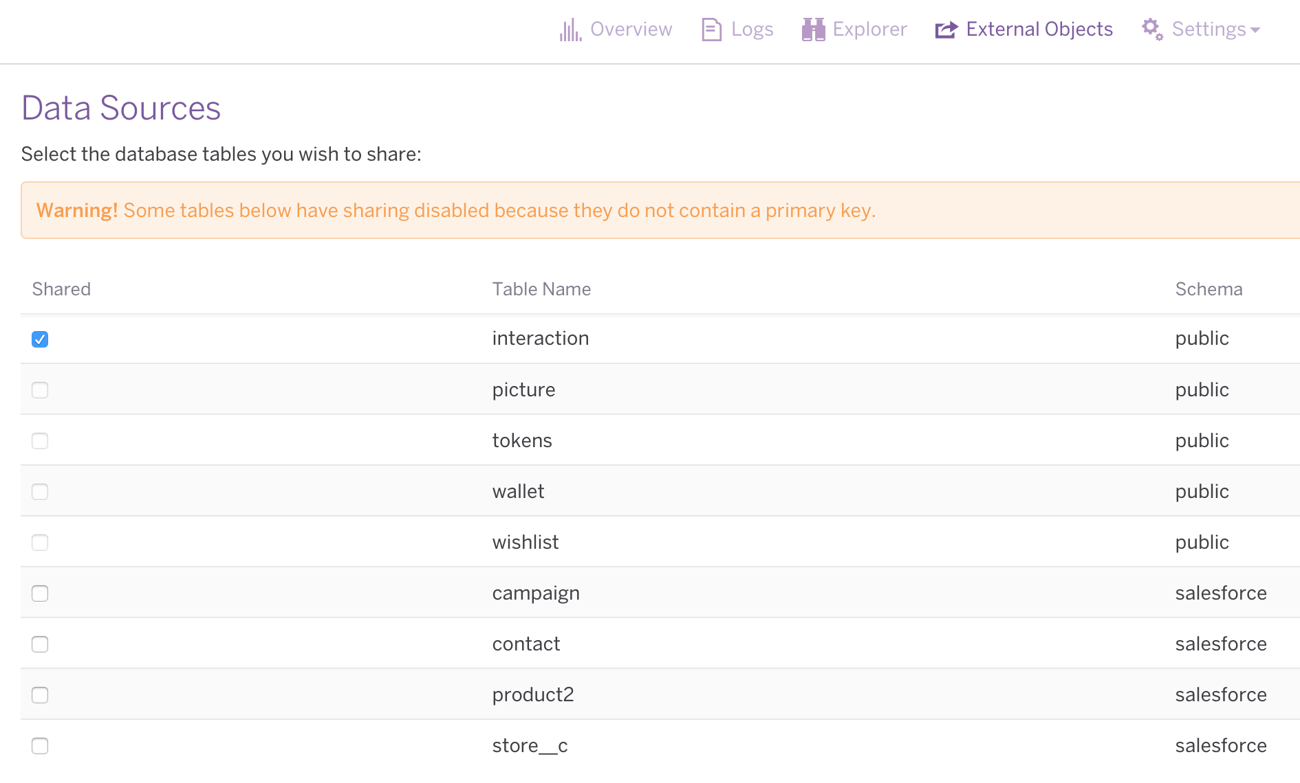
Configure External Objects in Heroku Connect
On the Heroku Connect Dashboard, click the External Objects tab and then the “Create and Email Username/Password button (you’ll receive an email with values you’ll need for the next slide)
Click the checkbox next to “interaction”

Slide 6
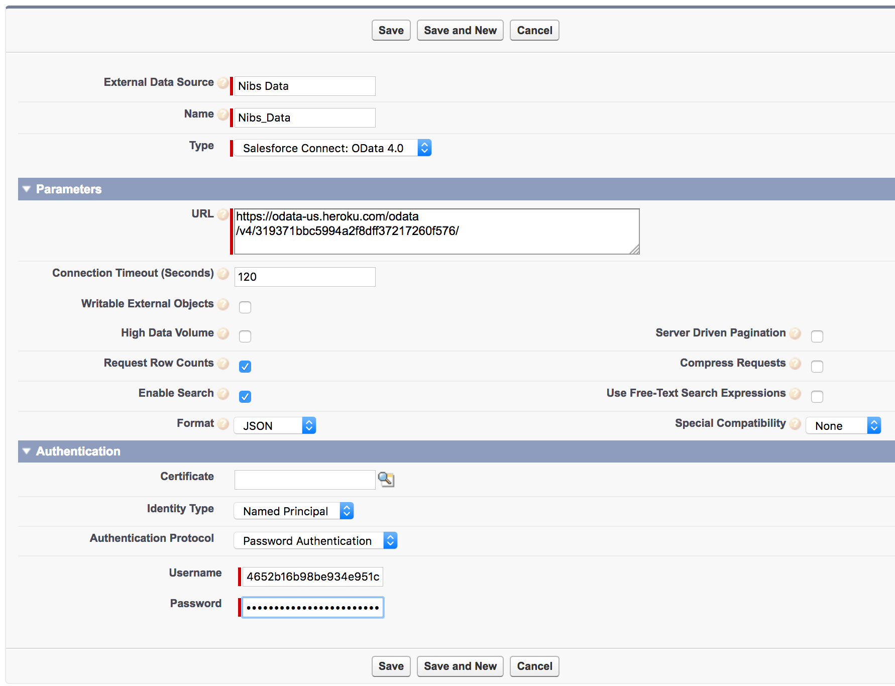
Configure External Data Source in Salesforce
Setup an External Data Source (Setup > Develop > External Data Source > New External Data Source
Fill the Data Source and Name with any value
Type = Salesforce Connect Odata 4.0
URL = Odata 4.0 Server URL value from the email you received
Identity Type = Named Principal
Authorization Protocol = Password Authentication
Username & Password = values from the email
Click “Save”

Slide 7
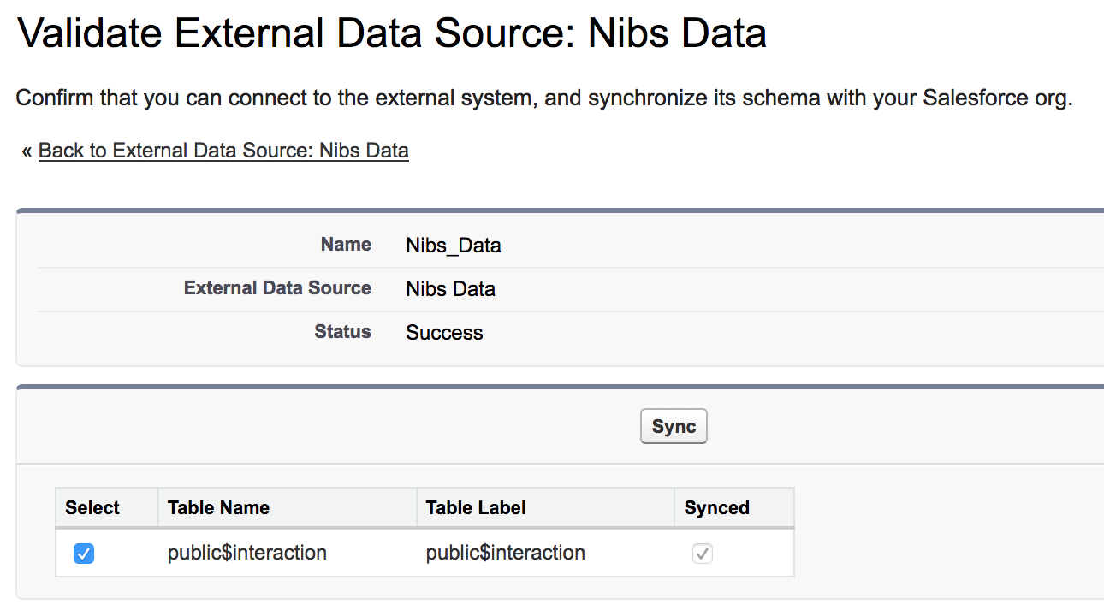
Expose the Interaction External Object
Click “Validate & Sync”
Select the checkbox next to public$interaction
Press “Sync”

Slide 8
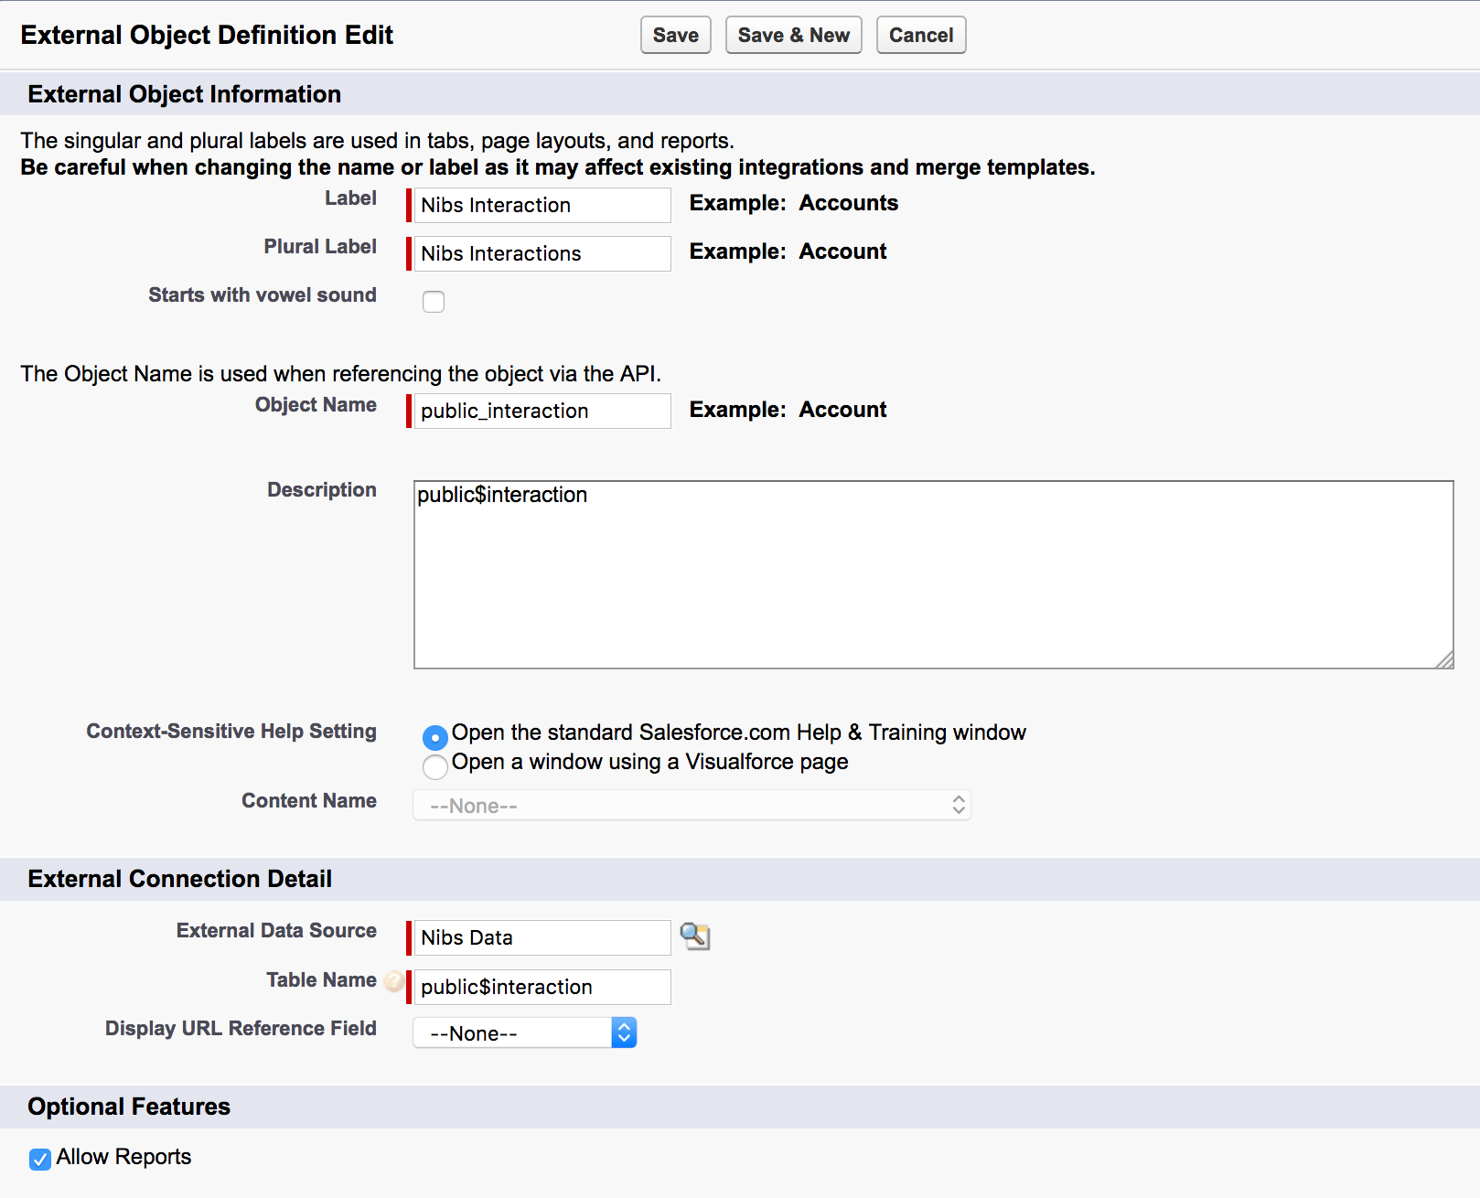
Modify the Interaction External Object
Click Edit next to public$interaction
Change the Label and Plural Label to “Nibs Interaction” and “Nibs Interactions”
Click the “Allow Reports” checkbox

Slide 9
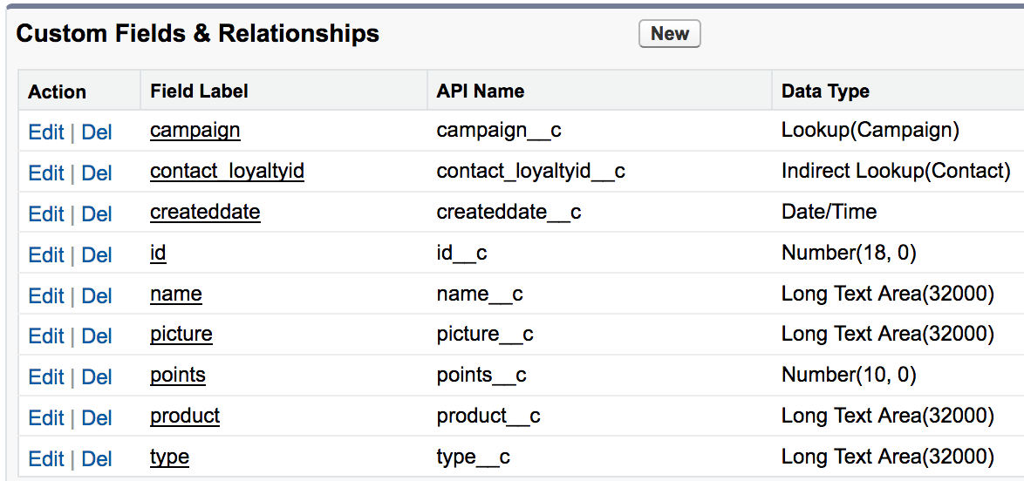
Modify the Interaction External Object (continued)
Setup > Develop > External Objects > click on the label of your external object
Edit the “campaign” custom field and change the data type to a Lookup to the Campaign object
Edit the “contact loyaltyID” custom field and change the data type to an Indirect Lookup Relationship to Contact. The Target Field is loyaltyId__c. The length will also need to be changed to 255.
Edit the “points” custom field to change the number of decimal places to 0.
You’ll also need to change the case sensitivity on the Contact object’s Loyalty App ID field to ‘Unique Case Sensitive’

Slide 10
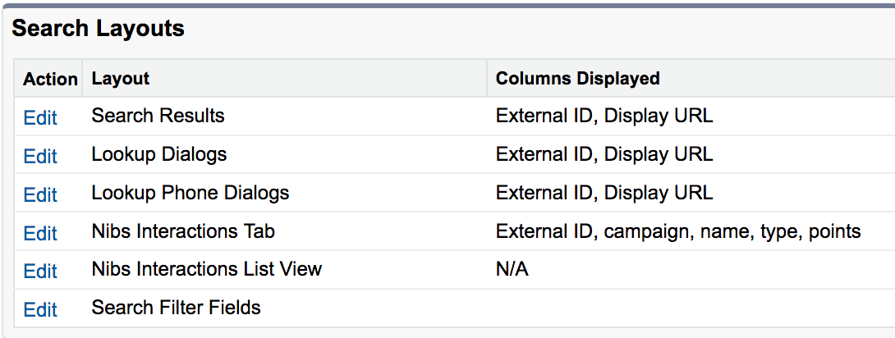
Navigation Enhancements
Create a tab for the Nibs Interactions object (Setup > Create > Tabs)
Add to the Loyalty Application
Optionally recorder tabs (after the tab is created, navigate to Setup > Create > Apps) and edit the Loyalty app)
Modify the Search Layout
Navigate to Setup > Develop > External Objects > click on the object name > click the “Nibs Interactions” label and ”edit” next to the “Nibs Interactions Tab” under Search Layouts
Add Campaign, name, type, and points fields
Optionally remove Display URL

Slide 11
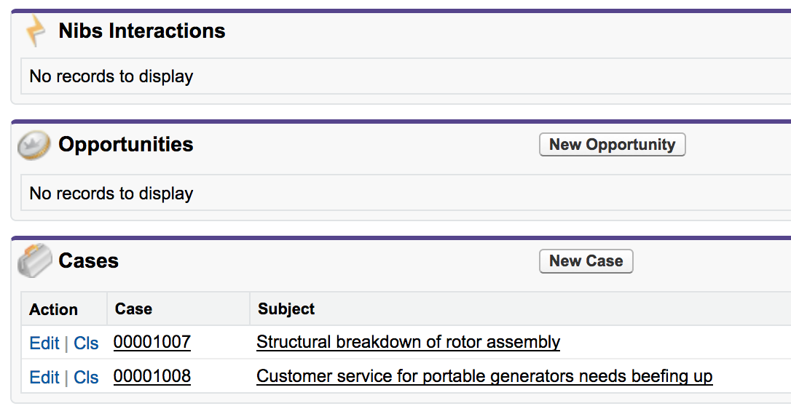
Navigation Enhancements (continued)
Change the Contact Page Layout (Customize > Contacts > Page Layouts > Edit Page Layout Assignment
Change the System Administrator Profile to use the Nibs Contact Layout
Add the Nibs Interactions related list to the Contacts object
Note: there aren’t any records yet… we haven’t created any

Slide 12
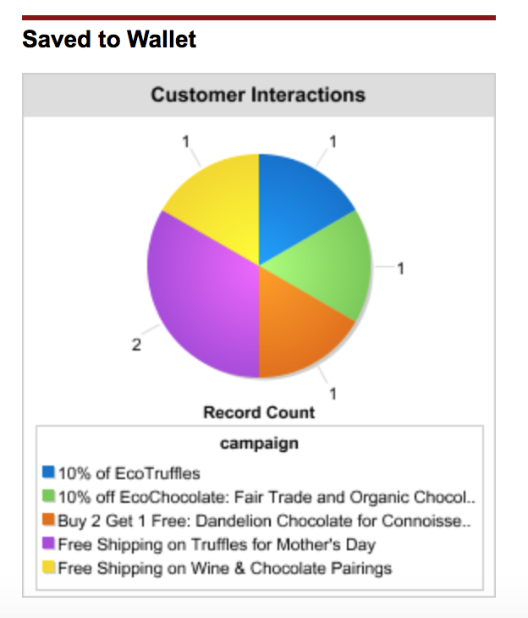
Reports & Dashboards (optional)
This might be a good time to show Salesforce’s ability to create reports and dashboards from External objects.
To do this, create a report using the “Nibs Interaction” object and add a component to the Customer Interactions Dashboard.

Slide 13
Nibs Architecture
Heroku Postgres
Heroku Connect
Contact
Sync
Contact
Campaign
Campaign
Product
Product
Store
Store
Interaction
External Objects
Interaction
Nibs App

